Slide 1



CIS 467 :Data Mining
Department of Information Systems
Faculty of Information Technology and Computer Sciences
Yarmouk University – Jordan
Prof. Dr. Qasem Al-Radaideh
© Qasem Al-Radaideh
Notes:
1

Slide 2
Topic 6 Cluster Analysis Part 2
The K-Means Clustering Algorithm
Main Source: J. Han Book
Data Mining: Concepts and Techniques (3nd ed.)
(Chapter 10)
10
9
8
7
6
5
4
3
2
1
2
0
0
1
2
3
4
5
6
7
8
9
10
Notes:
2

Slide 3
The K-Means Clustering Algorithm
K-Means algorithm introduced by J.B. MacQueen in 1967, is one of the most common clustering algorithms that groups data with similar characteristics or features together.
The K-Means algorithm is a statistical unsupervised clustering technique.
All input attributes to the algorithm must be numeric and
The user is required to make a decision about how many clusters are to be discovered (k).

Slide 4
The K-Means Clustering Method (1)
1) Initially, the number of clusters must be known, or chosen, to be K say.
2) The initial step is the choose a set of K instances as centres of the clusters. Often chosen such that the points are mutually “farthest apart”, in some way.
3) Next, the algorithm considers each instance and assigns it to the cluster which is closest.
4) The cluster centroids are recalculated using one of two methods either:
1) after each instance assignment, or
2) after the whole cycle of re-assignments.
5) This process is iterated.
We use this option
First Way

Slide 5
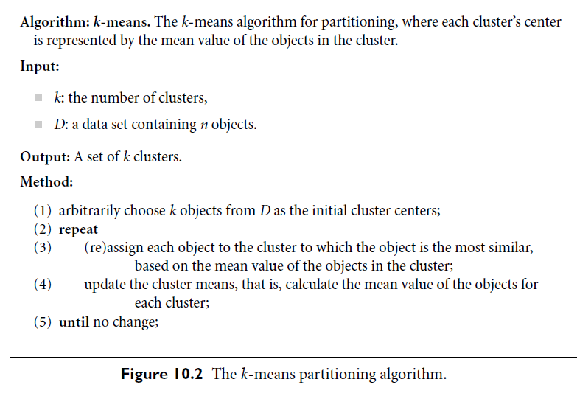

The K-Means: From Book

Slide 6
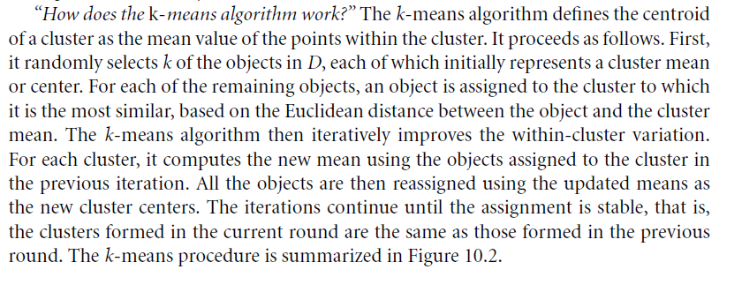
The K-Means: From Book

Slide 7
The K-Means Clustering Method (2)
Given k, the k-means algorithm is implemented in four steps:
1) Partition objects into k nonempty subsets
2) Compute seed points as the centroids of the clusters of the current partition (the centroid is the center, i.e., mean point, of the cluster)
3) Assign each object to the cluster with the nearest seed point
4) Go back to Step 2, stop when no more new assignment
Second Way

Slide 8
Summary K-Means Algorithm: We have 4 variations
A) For finding the initial clusters we have two options:
Option 1: Select the first K points randomly and assign them as the centroid of the K clusters, then start clustering. (Default)
Option 2: Partition the points into K folds and assign each fold to a cluster, then find the centroid for each cluster, then start clustering.
B) For updating the centroid of the clusters we have two options:
Option 1: Update the centroid after each assignment of a point. (Default)
Option 2: Update the centroid at the end of each iteration (Cycle).

Slide 9
Illustration of the K-Means Clustering Method
Example
10
10
9
9
8
8
7
7
6
6
5
5
4
Assign each objects to most similar center
Update the cluster means
4
3
3
2
2
1
1
0
0
0
1
2
3
4
5
6
7
8
9
10
0
1
2
3
4
5
6
7
8
9
10
reassign
reassign
K=2
Arbitrarily choose K object as initial cluster center
Update the cluster means

Slide 10
K-Means Algorithm: Example 1
For a very simple example of five points in two dimensions, observe Fig. below. Suppose we assign the points 1, 2, 3, 4, and 5 in that order, with k = 2. Then the points 1 and 2 are assigned to the two clusters, and become their centroids for the moment.
1
5
a
3
c
2
4
b

Slide 11
K-Means Algorithm: Discussion of Example 1
When we consider point 3, suppose it is closer to 1, so 3 joins the cluster of 1, whose centroid moves to the point indicated as a.
Suppose that when we assign 4, we find that 4 is closer to 2 than to a, so 4 joins 2 in its cluster, whose center thus moves to b.
Finally, 5 is closer to a than b, so it joins the cluster {1; 3}, whose centroid moves to c.

Slide 12
K-Means Clustering: Example 2 (1)
Q) Suppose that we are given the following 9 items to cluster:
{2, 4, 10, 12, 3, 20, 30, 11, 25}
and suppose that K=2 (C1 and C2).
Solution Steps:
We initially assign the means to the first two values:
m1 = 2 and m2 =4.
Using Euclidean distance, we find that initially
C1 = {2, 3} and C2 = {4, 10, 12, 20, 30, 11, 25}.
Note: The value 3 is equally close to both means, so we arbitrarily choose K1. Any desired assignment could be used in the case of ties.
We then recalculate the means to get m1=2.5 and m2=16.
We again make assignments to clusters to get:
C1= {2, 3, 4} and C2 = {10, 12, 20, 30, 11, 25}.
Note: In this Example we re-calculate the centroid after we assign each value.
Notes:
1) m1-x1=d1, i.e. 2-2=0 vs m2-x1=4-2=2; ➔ x1 belongs to K1. m1-x2=d2, i.e. 2-4=2 vs m2-x2= 4-4=0; ➔x2 belongs to K2, etc.
m1= (2+3)/2 = 2.5; m2 = (4+10+12+20+30+11+25)/7 = 112/7 = 16.

Slide 13
K-Means Clustering: Continue Example 2 (2)
(Dunham, 2003)
Continuing in this fashion, we obtain the following:
m1 | m2 | C1 | C2
3 | 18 | {2, 3, 4, 10} | {12, 20, 30, 11, 25}
4.75 | 19.6 | {2, 3, 4, 10, 11, 12} | {20, 30, 25}
7 | 25 | {2, 3, 4, 10, 11, 12} | {20, 30, 25}
Note that the clusters in the last two steps are identical. This will yield identical means, and thus the means have converged.
Our answer is thus C1 = {2, 3, 4, 10, 11, 12} and C2 = {20, 30, 25}.

Slide 14
Example 2:
Given the following data set (D),
Cluster the instances into 2 clusters using K-Means clustering method and the Euclidian distance. (Use First Way)
 | A1 | A2
X1 | 10 | 15
X2 | 8 | 11
X3 | 12 | 12
X4 | 15 | 18
X5 | 16 | 3
X6 | 4 | 6
X7 | 9 | 8
To be Solved at Class
For solution
see a separate presentation
Cluster 1
Cluster 2
Solution
Note: In this Example re-calculate the centroid after we assign each instance.

Slide 15
Summary K-Means Algorithm: We have 4 variations
A) For finding the initial clusters we have two options:
Option 1: Select the first K points randomly and assign them as the centroid of the K clusters, then start clustering. (Default)
Option 2: Partition the points into K folds and assign each fold to a cluster, then find the centroid for each cluster, then start clustering.
B) For updating the centroid of the clusters we have two options:
Option 1: Update the centroid after each assignment of a point. (Default)
Option 2: Update the centroid at the end of each iteration (Cycle).

Slide 16
Exercise / Home Work
Given the following data set,
Cluster the instances into 3 clusters using K-Means clustering and the Euclidian distance.
Cluster the instances into 2 clusters using K-Means clustering and the Euclidian distance.
Cluster the instances into 3 clusters using K-Means clustering and the Manhattan distance.
Try the same example using WEKA/Orange.
Note: You need to Convert the data set into ARFF format.
A1 | A2 | A3
10 | 14 | 5
9 | 11 | 6
12 | 12 | 7
15 | 18 | 3
16 | 3 | 4
4 | 6 | 5
6 | 8 | 10
17 | 9 | 11
8 | 13 | 15
7 | 17 | 5
10 | 9 | 6
11 | 17 | 3

Slide 17
Comments on the K-Means Method
Strength: Relatively efficient: O(tkn), where n is # objects, k is # clusters, and t is # iterations. Normally, k, t << n.
Comparing: PAM: O(k(n-k)² ), CLARA: O(ks² + k(n-k))
Comment: Often terminates at a local optimum. The global optimum may be found using techniques such as: deterministic annealing and genetic algorithms
Weakness
Applicable only when mean is defined, then what about categorical data?
Need to specify k, the number of clusters, in advance
Unable to handle noisy data and outliers
Not suitable to discover clusters with non-convex shapes

Slide 18
Variations of the K-Means Method (K-Modes)
A few variants of the k-means which differ in
Selection of the initial k means
Dissimilarity calculations
Strategies to calculate cluster means
Handling categorical data: k-modes (Huang’98)
Replacing means of clusters with modes
Using new dissimilarity measures to deal with categorical objects
Using a frequency-based method to update modes of clusters
A mixture of categorical and numerical data: k-prototype method
K-Modes: To be presented by one of the good students with Complete example.

Slide 19
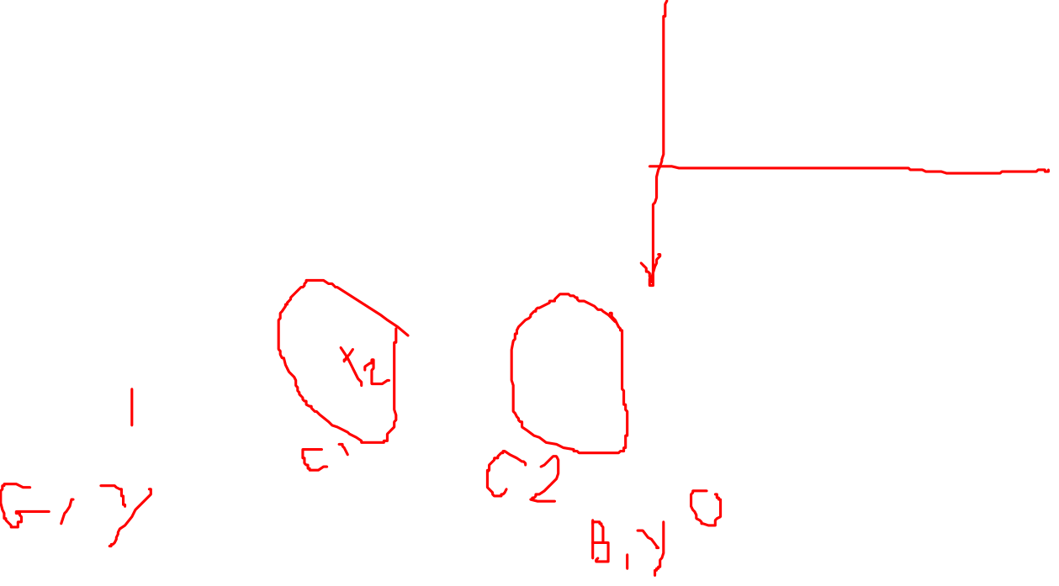
Example for K-Modes:
Given the following data set (D),
Cluster the instances into 2 clusters using K-Modes clustering method and the Euclidian distance. (Use Second Way)
 | A1 | A2
X1 | Good | Yes
X2 | Bad | Yes
X3 | Good | No
X4 | Good | Yes
X5 | Bad | Yes
X6 | Bad | Yes
X7 | Bad | No
To be Solved at Class
Note: In this Example re-calculate the centroid after we assign each instance.

Slide 20
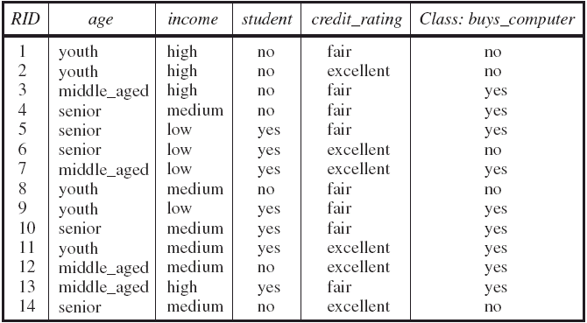
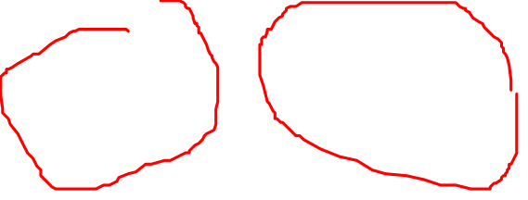
Exercise / Home Work (K-Modes):
Given the following data set (D), Cluster the instances into 2 clusters using K-Modes clustering method.

Slide 21
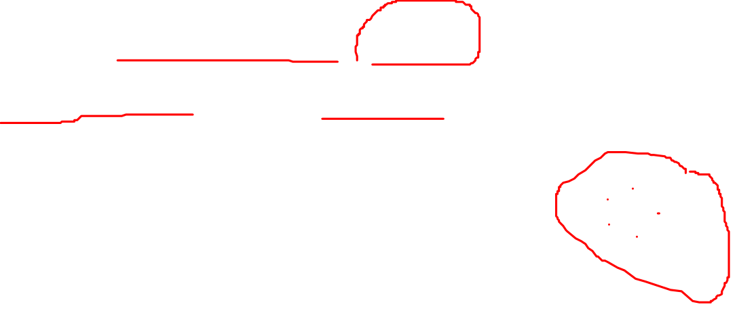
What Is the Problem of the K-Means Method?
The k-means algorithm is sensitive to outliers !
Since an object with an extremely large value may substantially distort the distribution of the data.
K-Medoids: Instead of taking the mean value of the object in a cluster as a reference point, medoids can be used, which is the most centrally located object in a cluster.
10
10
9
9
8
8
7
7
6
6
5
5
4
4
3
3
2
2
1
1
0
0
1
2
3
4
5
6
7
8
9
10
0
0
1
2
3
4
5
6
7
8
9
10

Slide 22
Summary: Variation of the K-Means Method?
k-means
K-Modes
K-Medoids
K-Prototype
Note: You need to know the difference between them and when we use each one of these variations.

Slide 23


End … Thanks
Dr. Qasem Al-Radaideh
Yarmouk University

